Slide 1
Moment of a Force About a Point (vector calculation)
Dr. Jacob Moore
Associate Professor of Engineering
Penn State Mont Alto

Slide 2
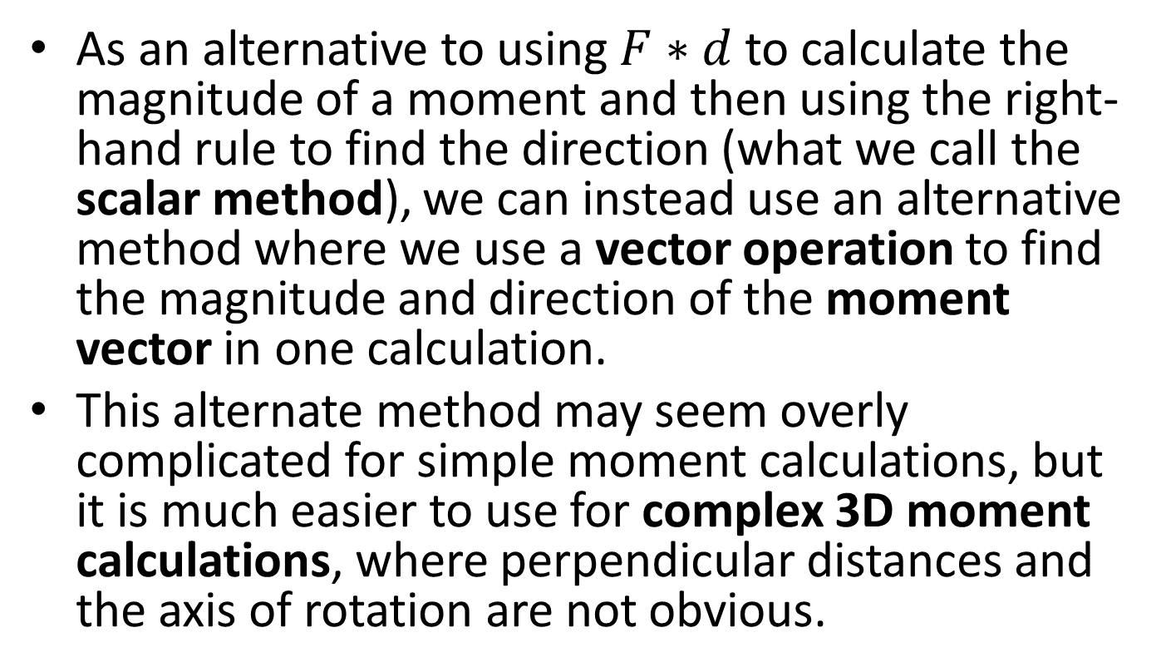
Moment of a Force About a Point (Vector Calculations)
As an alternative to using $F∗d$ to calculate the magnitude of a moment and then using the right-hand rule to find the direction (what we call the scalar method), we can instead use an alternative method where we use a vector operation to find the magnitude and direction of the moment vector in one calculation.
This alternate method may seem overly complicated for simple moment calculations, but it is much easier to use for complex 3D moment calculations, where perpendicular distances and the axis of rotation are not obvious.

Slide 3
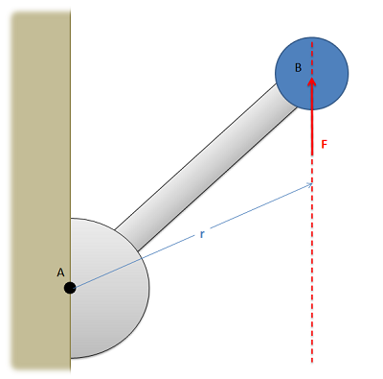
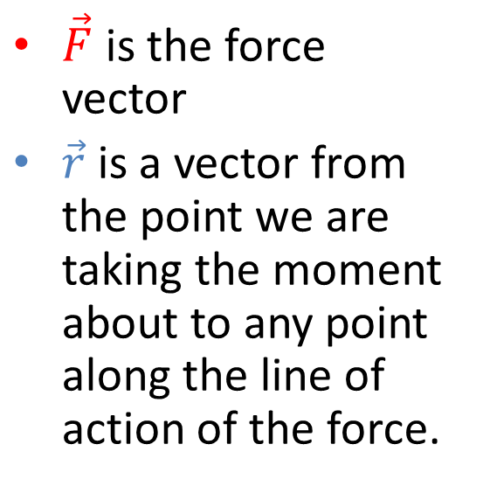
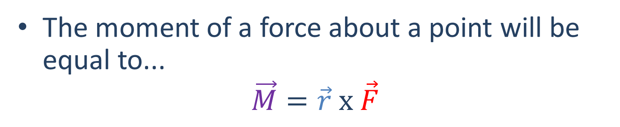
Moment of a Force About a Point (Vector Calculation)
The moment of a force about a point will be equal to...
$$\vec{M}=\vec{r} x \vec{F}$$
$\vec{F}$ is the force vector
$\vec{r}$ is a vector from the point we are taking the moment about to any point along the line of action of the force.

Slide 4
The Cross Product
The cross product is a mathematical operation we can perform with any two, three dimensional vectors.
The result is a third vector, perpendicular to the first two, which will also have three elements.
It’s important to note the cross product is not communicative, meaning that the order does matter for the input vectors.

Slide 5
Calculating The Cross Product
The first step in determining the cross product is to determine all three components of both the r and the F vectors.
Even for 2D vectors we will need to list x, y, and z components.
From there we can either...
calculate the cross product by hand,
or use a computer tool such as Matlab to calculate the cross product.
See section A 1.4 for more on calculating the cross product
Generally, it’s the use of computer tools that makes the cross-product calculation easier than scalar calculations

Slide 6
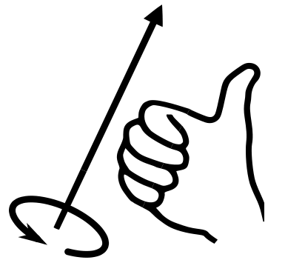
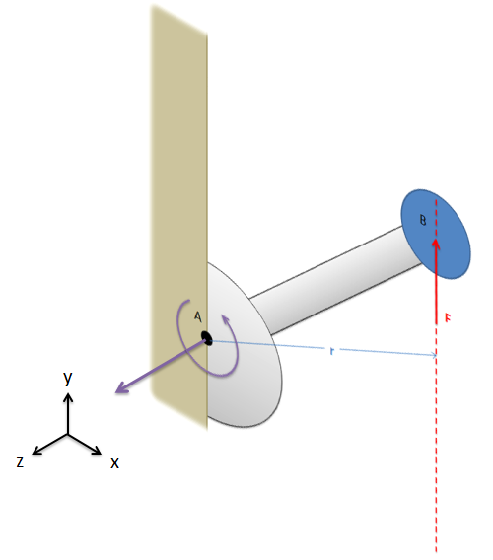
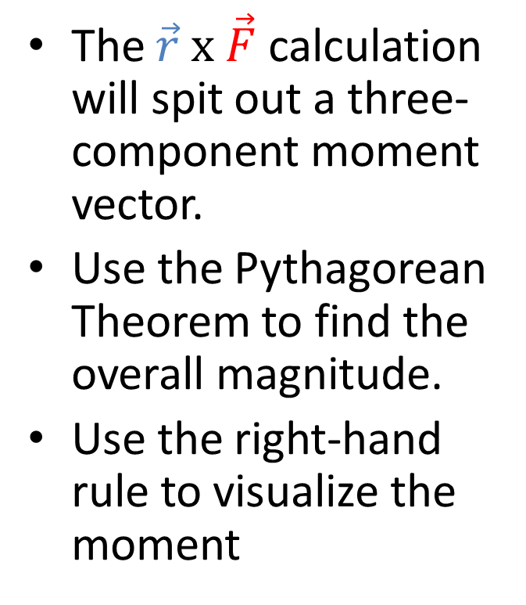
Vector Representation of a Moment
The $\vec{r} x \vec{F}$ calculation will spit out a three-component moment vector.
Use the Pythagorean Theorem to find the overall magnitude.
Use the right-hand rule to visualize the moment

Slide 7
Thanks for Watching
See other engineering mechanics videos and access the full tool at…

Slide 8

Moment of a Force About a Point Worked Example
What is the magnitude of the moment that the force shown below force exerts about point O?
1 m
50 N
1.8 m
O

Slide 9
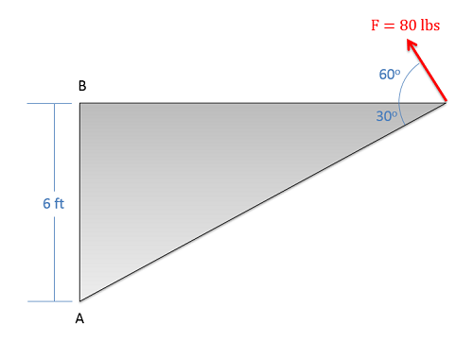
Moment of a Force About a Point Worked Example
What is the magnitude of the moment that this force exerts…
about point A?
about point B?

Slide 10
Moment of a Force About a Point Worked Example
What is the moment that the force shown below exerts about the base of the pole at O? Leave your answer as a moment vector.
y
30 cm
30 cm
60 N
40 cm
x
O
z

Slide 11
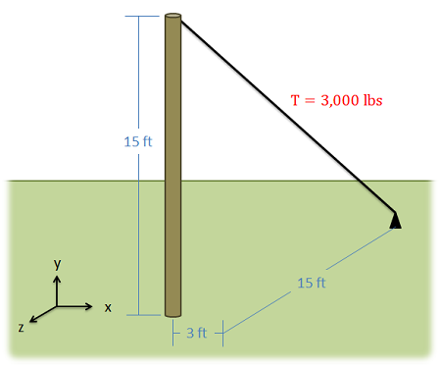
Moment of a Force About a Point Worked Example
A cable attached to the top of a pole as shown below carries a 3000 lb tension force.
What is the moment vector this causes about the base of the pole?
What is the overall magnitude of the moment about the base of the pole?

